Slide 1
Analog vs Digital Waves
8th Grade Science

Slide 2
How to take notes…
Watch the power point including any videos
Listen to the lecture
Record information on your notes
Use the “Check your notes” slides to ensure you have the correct information.
DON’T WORRY ABOUT THE COLORS ON THE NOTES! This is only provided as a way to see a difference between the information.

Slide 3
FOLD your notes so the “Analog vs Digital” on the bottom is visible

Slide 4
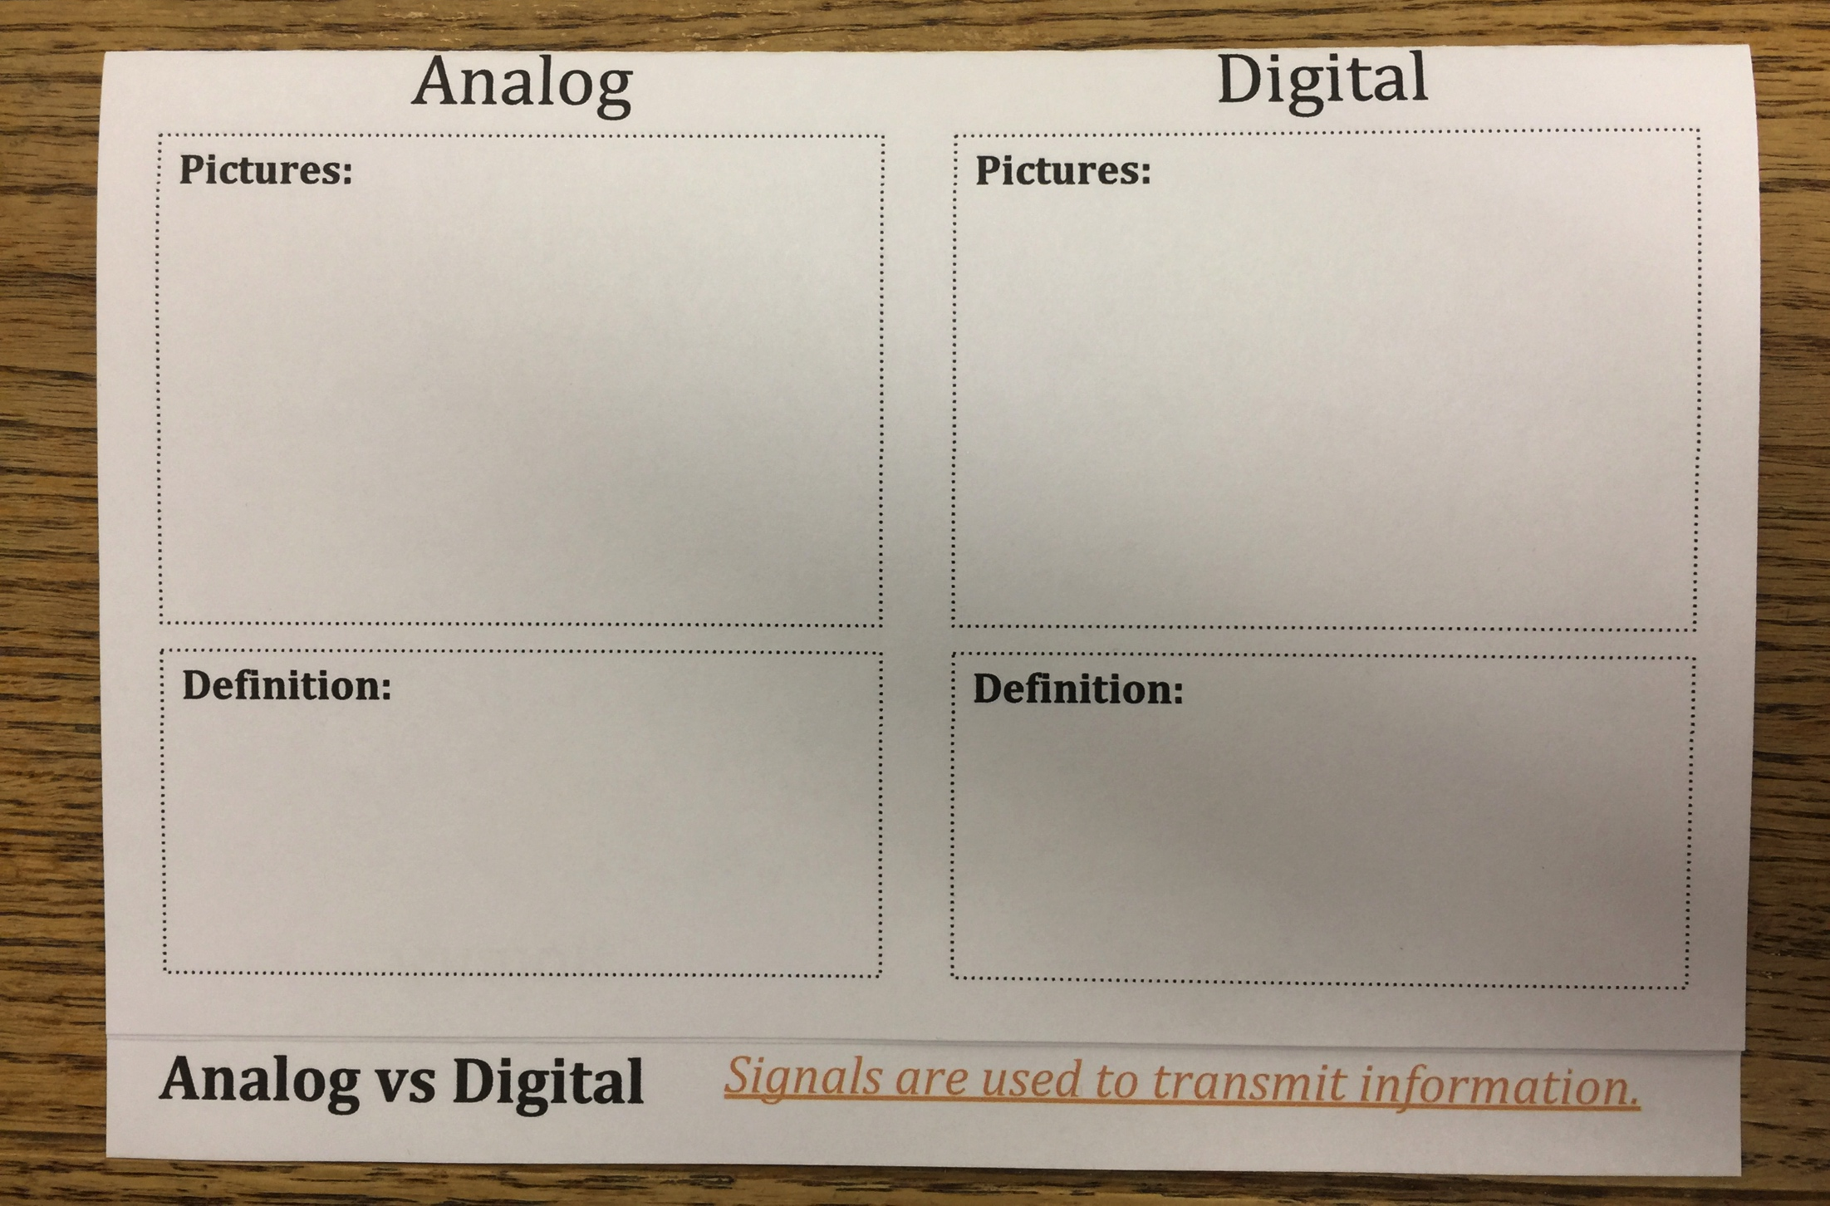
Analog & Digital
Signals are used to transmit information

Slide 5
Analog
Analog signals are continuous electric pulses of varying amplitudes.
*Remember amplitude is the height of the wave!

Slide 6
Devices that use analog signals
Draw each of these pictures onto the front of your notes under the “Analog” section.

Slide 7
Check your Notes…
Your “Analog” Notes should look similar to this…

Slide 8
Digital
Digital signals translate the information into binary format
(zero’s OR one’s)
where each “bit” represents two distinct amplitudes.

Slide 9
Devices that use digital signals
Draw each of these pictures onto the front of your notes under the “Digital” section.

Slide 10
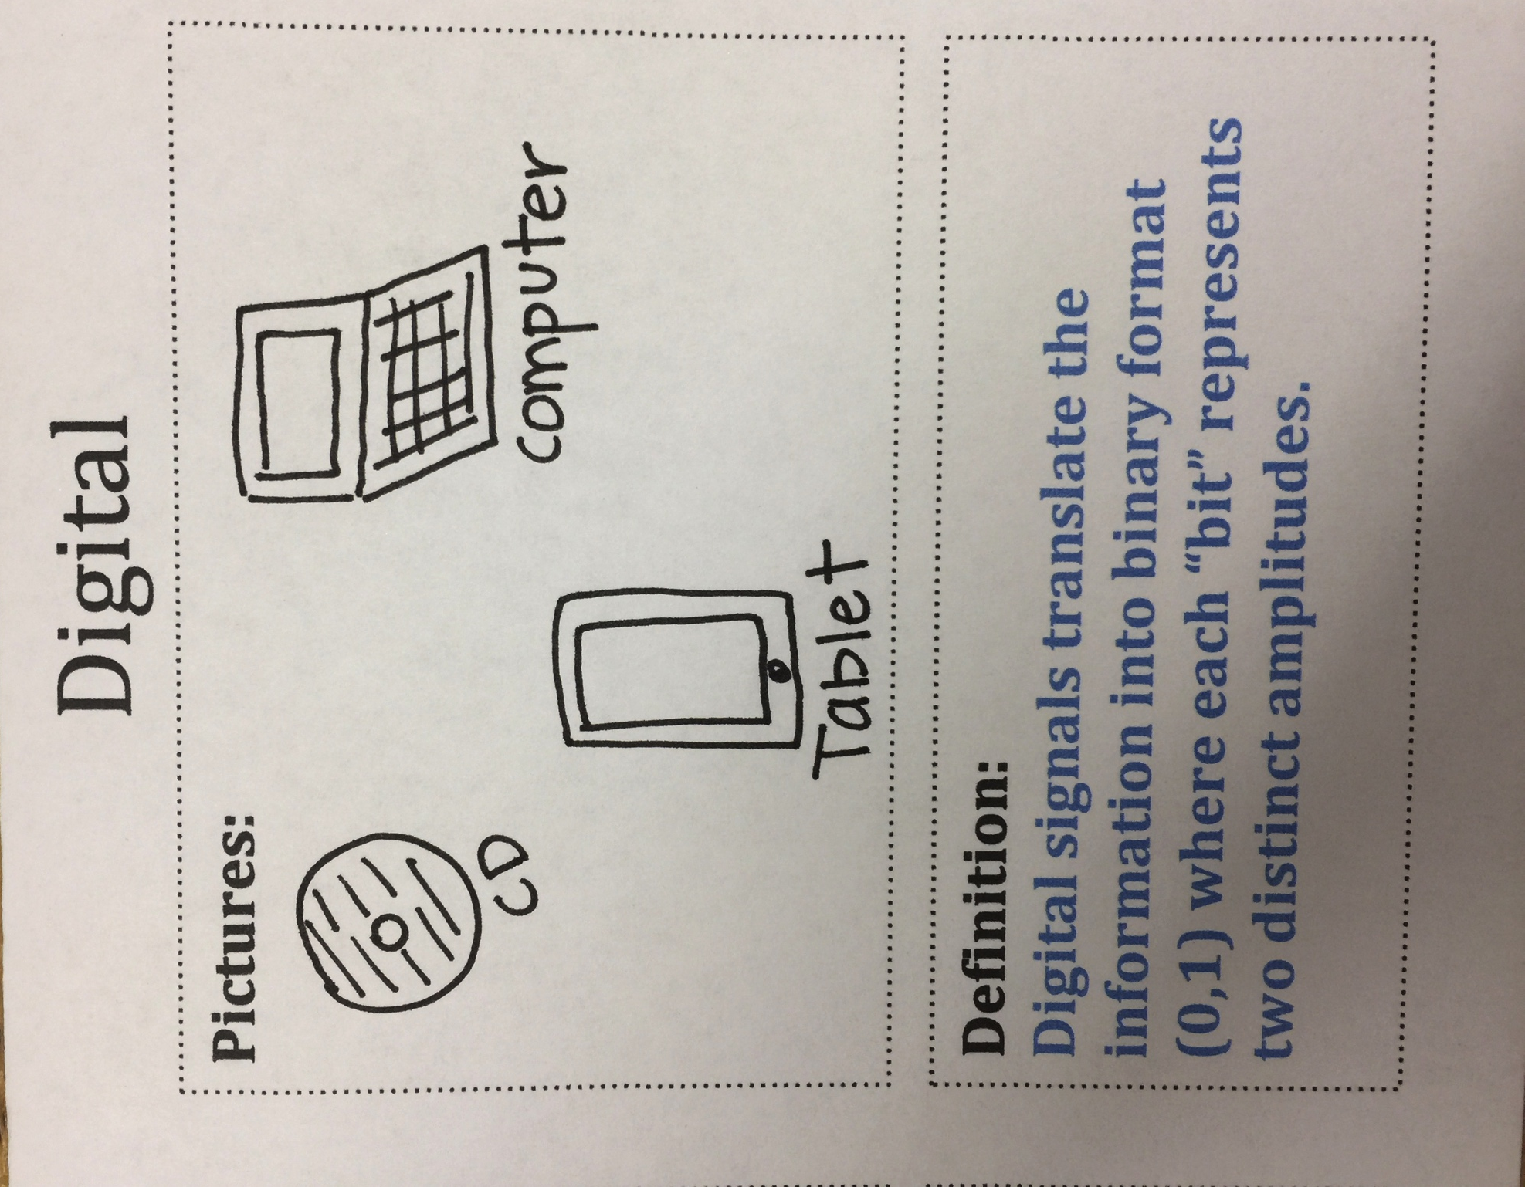
Check your Notes…
Your “Digital” Notes should look similar to this…

Slide 11
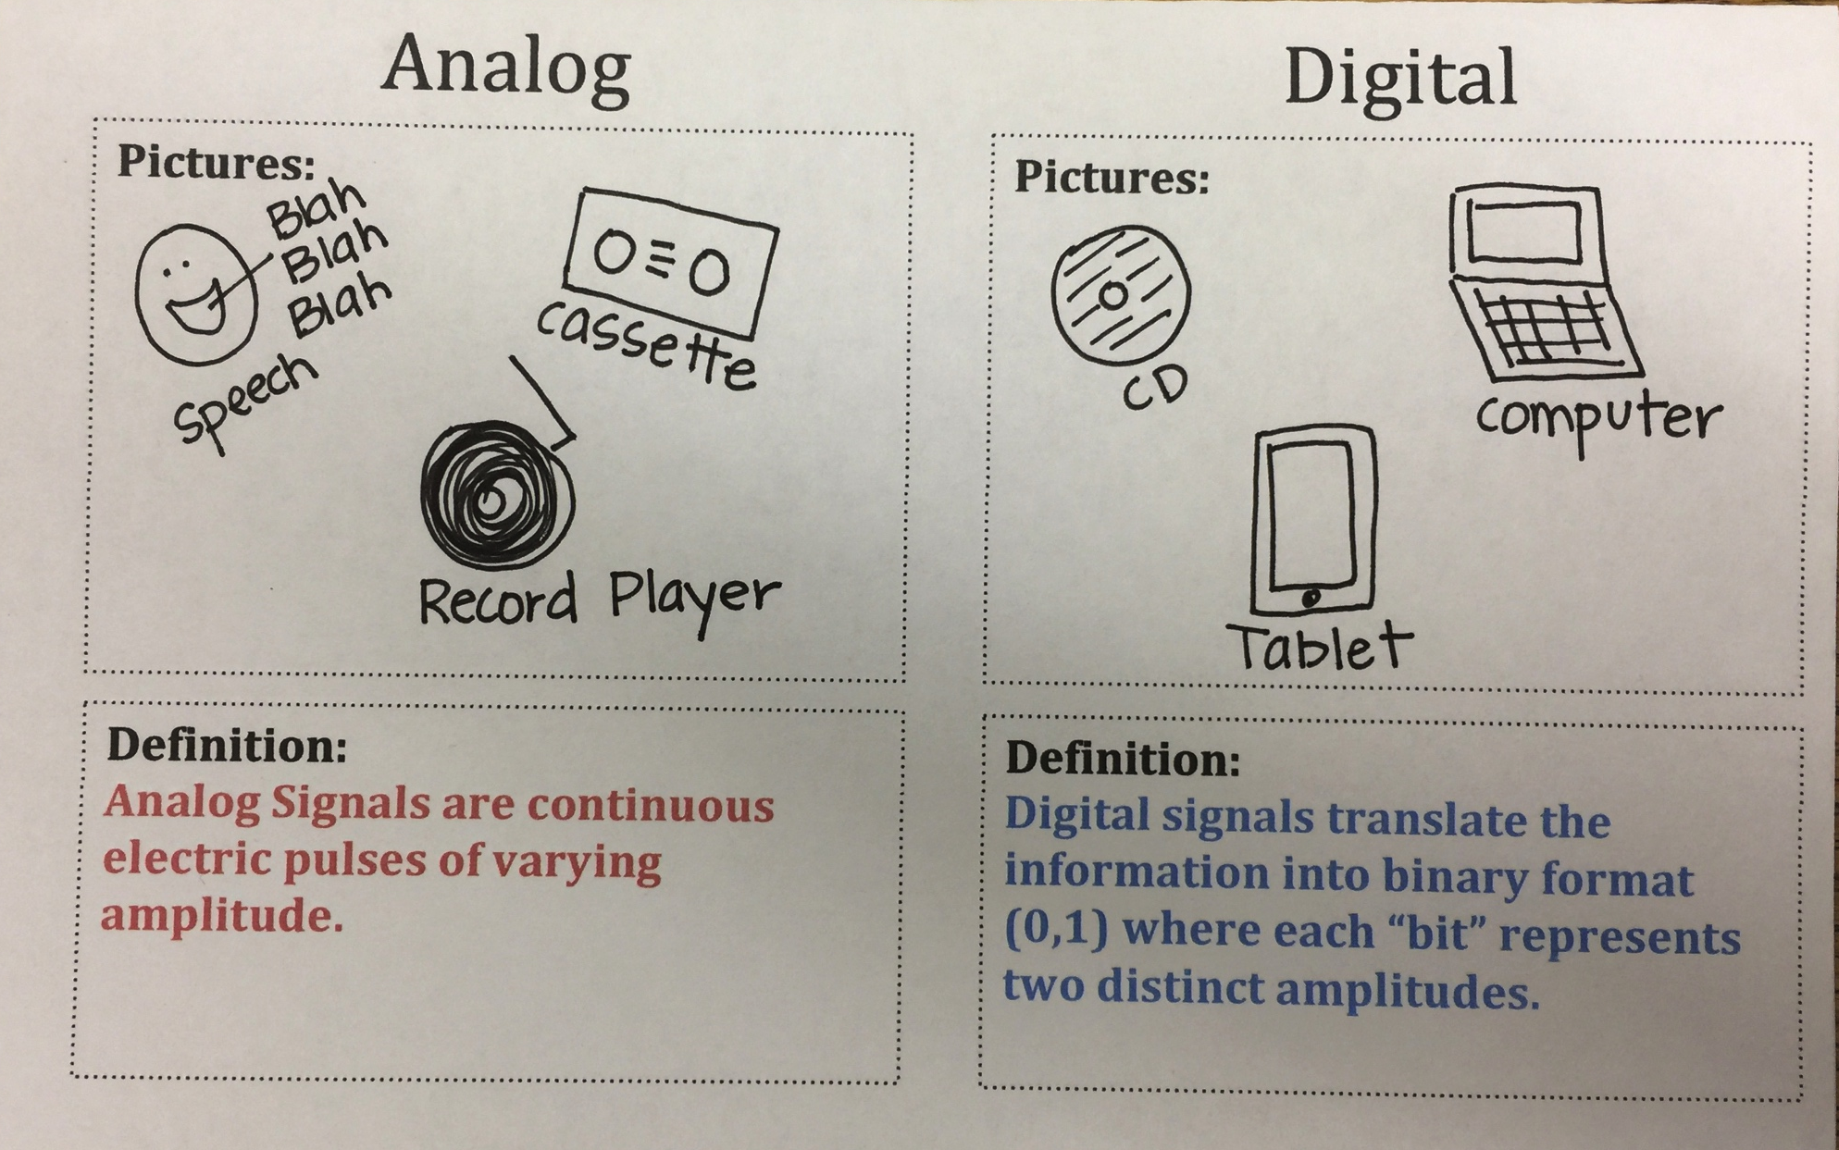
Check your Notes…
The Front of your notes…

Slide 12
Open your notes… We are going to look at the top portion!

Slide 13
Draw the following Analog wave onto your notes.
NOTICE: The sine wave moves up and down marking different amplitudes.

Slide 14
Analog
Analog signals are called “sine” waves or transverse waves.
These waves have different amplitudes.

Slide 15
1
0
Draw the following Digital wave onto your notes.
NOTICE: The digital “square” wave only has TWO amplitudes…ZERO or ONE. This binary format allows the signal to be read in code.

Slide 16
Digital
Digital signals are sine waves converted into a binary “pixel” format.
Digital waves are known as “SQUARE” waves.

Slide 17
Check your Notes…
The Inside TOP of your notes…

Slide 18
Now…move to the bottom portion of the notes.
Analog | Comparison Chart | Digital
Continuous | Signal | Individual “bits” of information
Sine Waves | Wave Type | Square Waves
Records, Cassette Tapes, Speech | Examples | CD’s, DVD’s, Digital Devices
Analog records the technology “as is” | Technology | Digital converts analog waves to binary format (0,1)
CAN be affected by noise during the wave transmission | Response to Noise | Noise Immune

Slide 19
Watch the following video…
Analog vs Digital Waves

Slide 20
You are all DONE!
Glue your notes into the next available page
in your notebooks.

