Slide 1
Biology Tic Tac Toe
Student Choice Activity

Slide 2
Tic Tac Toe is a 3 day project
Day 1 – Energy
Day 2 – Photosynthesis
Day 3 - Respiration

Slide 3
Day 1 - Energy
Energy Pathway Poster
Create a map tracing the path of energy from the sun to heat energy in an organism. Be sure to include photosynthesis and respiration in the path.
Your map should be fully colored and labeled.

Slide 4
Energy
Summary of Pathway
Starts with the sun (light or solar energy)
Light energy is captured by a plant where photosynthesis occurs
Photosynthesis results in food (chemical energy)
Organisms eat the food and cells undergo respiration
Energy from respiration is used for movement (mechanical energy)
Movement creates heat (heat energy)

Slide 5
Energy Poster Example

Slide 6
Energy Poster Example

Slide 7
Day 2 - Photosynthesis
Choose ONE of these projects
Booklet
or
Power Point

Slide 8
Booklet
Design and illustrate a booklet about PHOTOSYNTHESIS. Cover the importance of light energy as part of the chemical process that builds plant materials and provides food for the plant.
Include information about where photosynthesis takes place and what molecules are parts of this process.
Your booklet should be fully colored.
Must be 8 pages or more

Slide 9
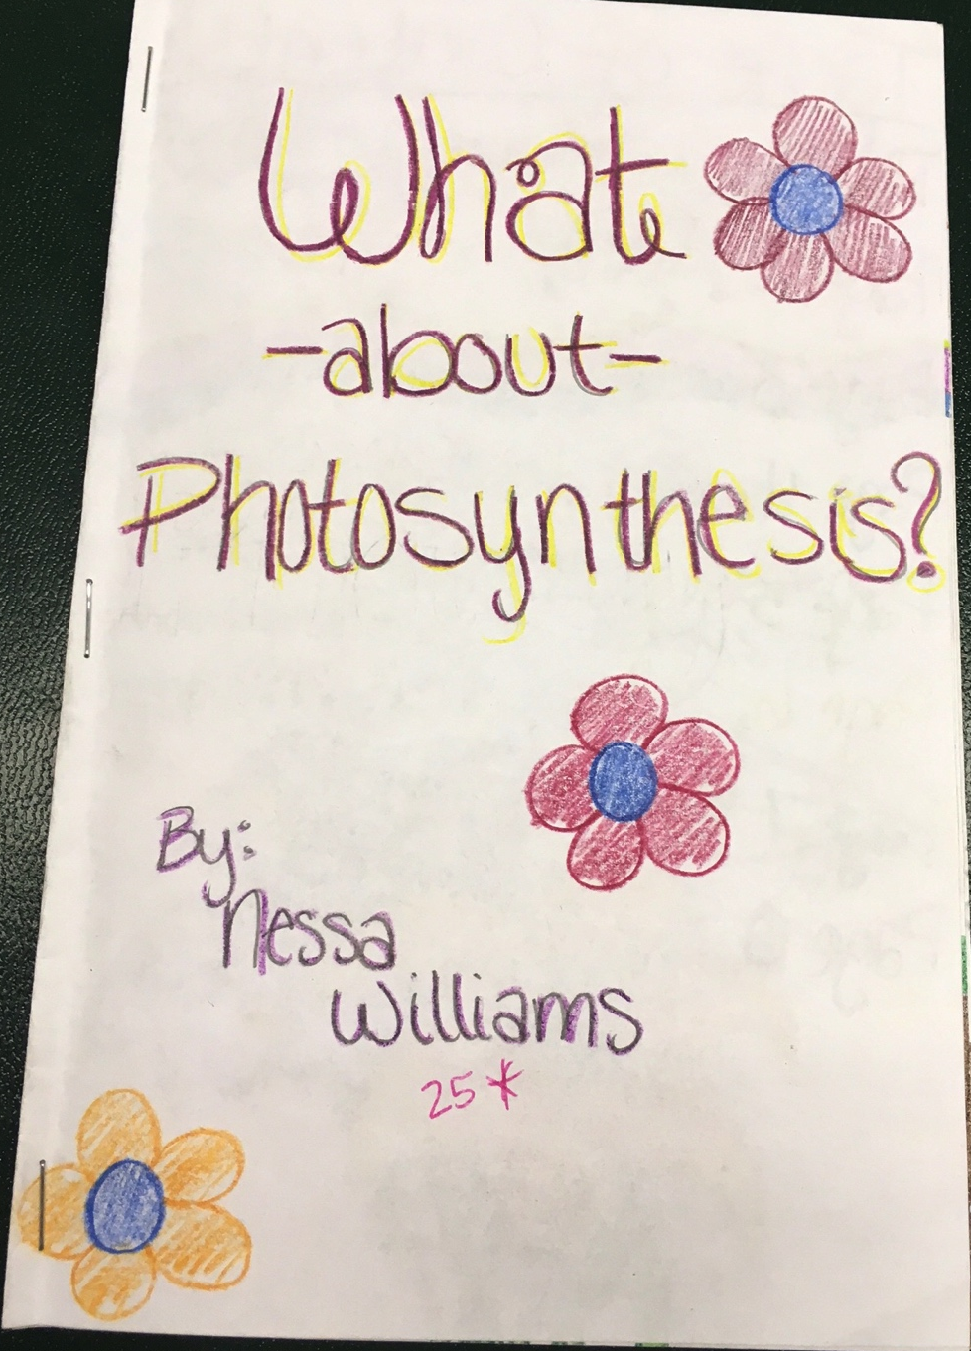
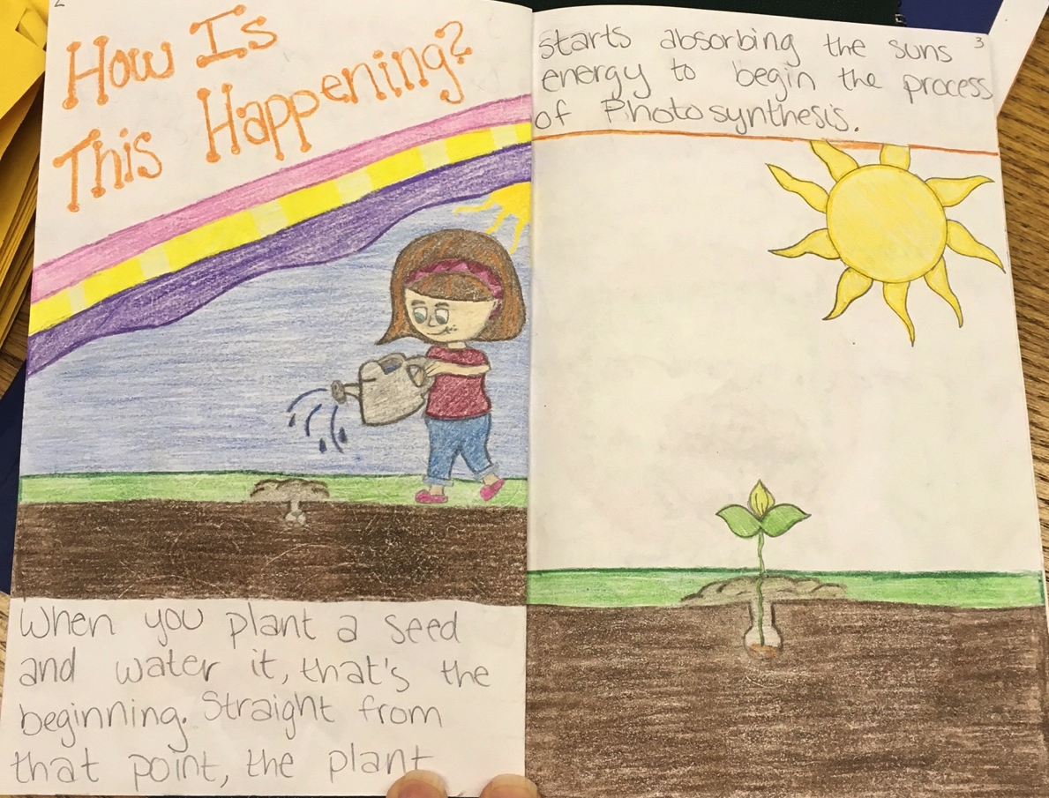
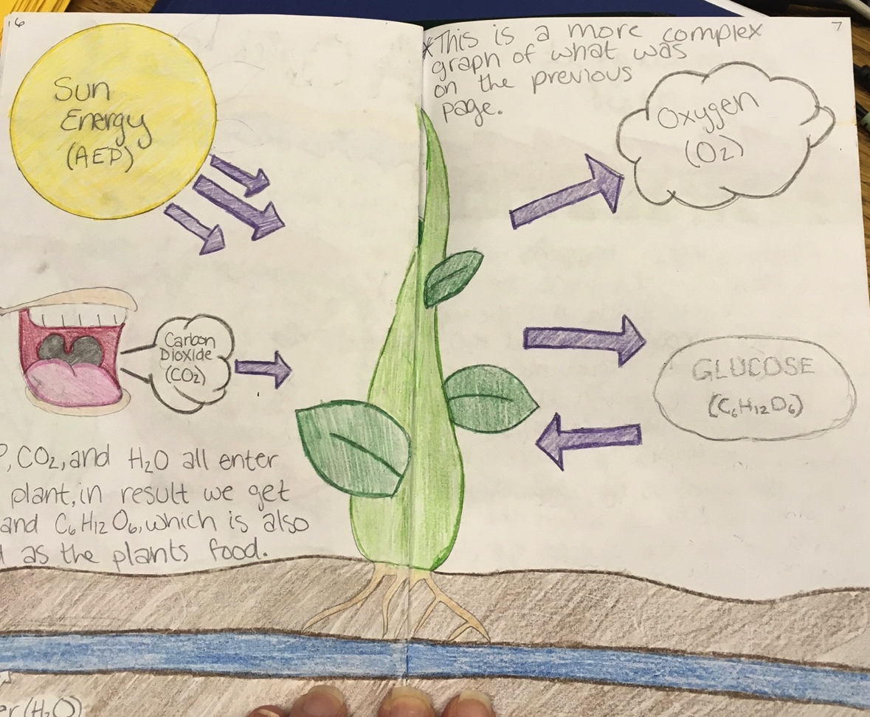
Booklet Example

Slide 10
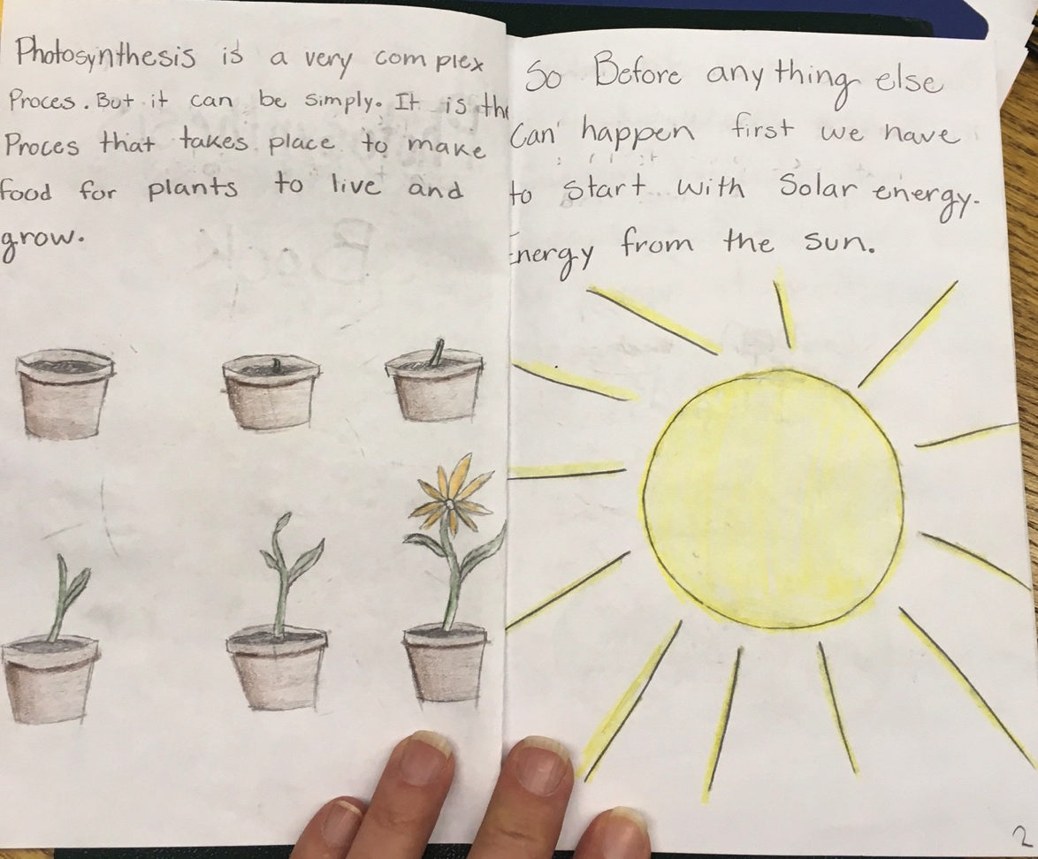
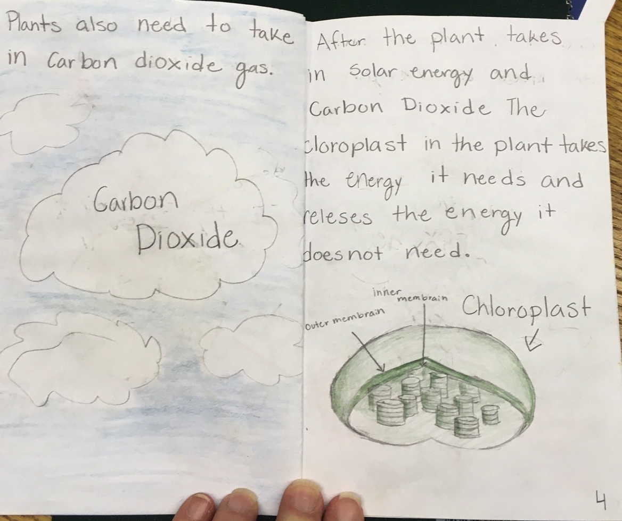
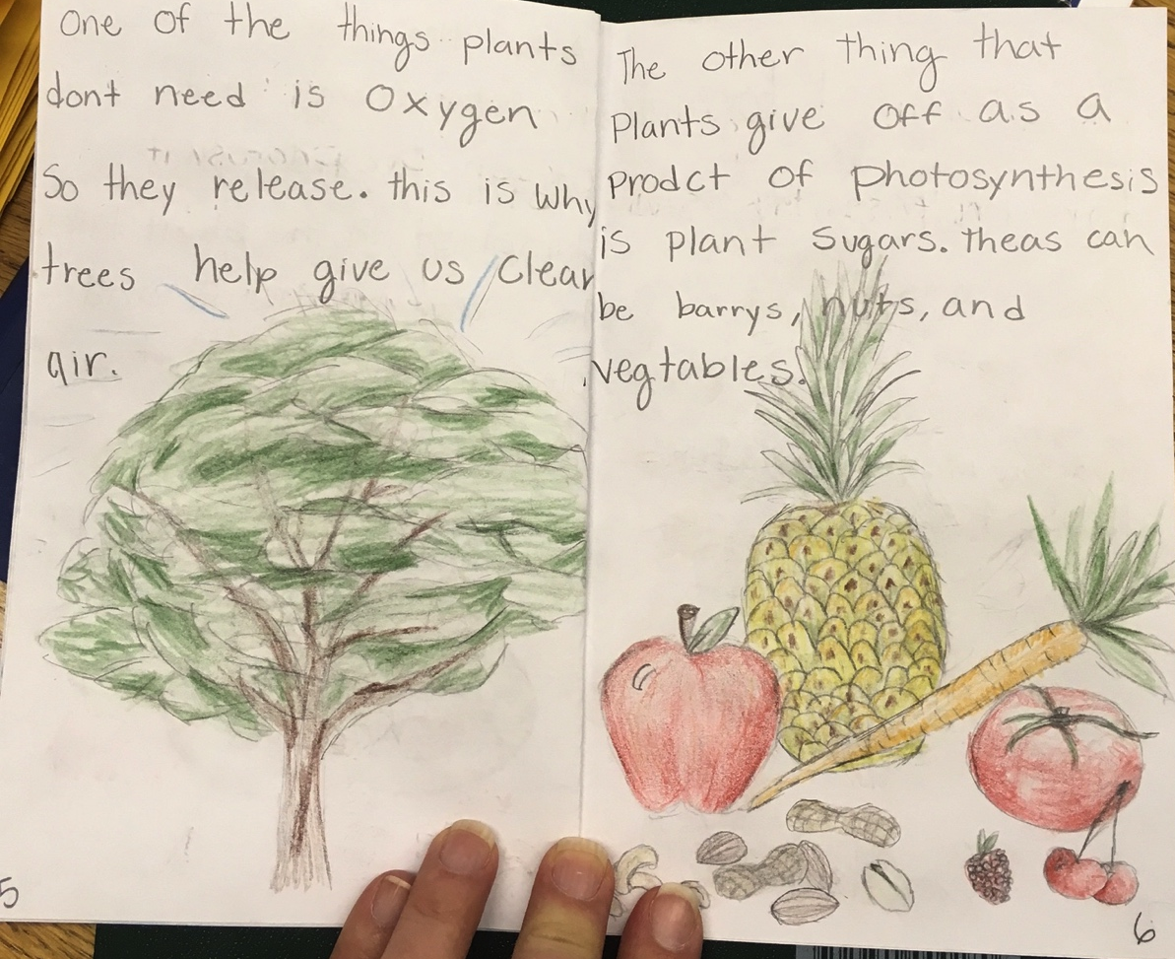
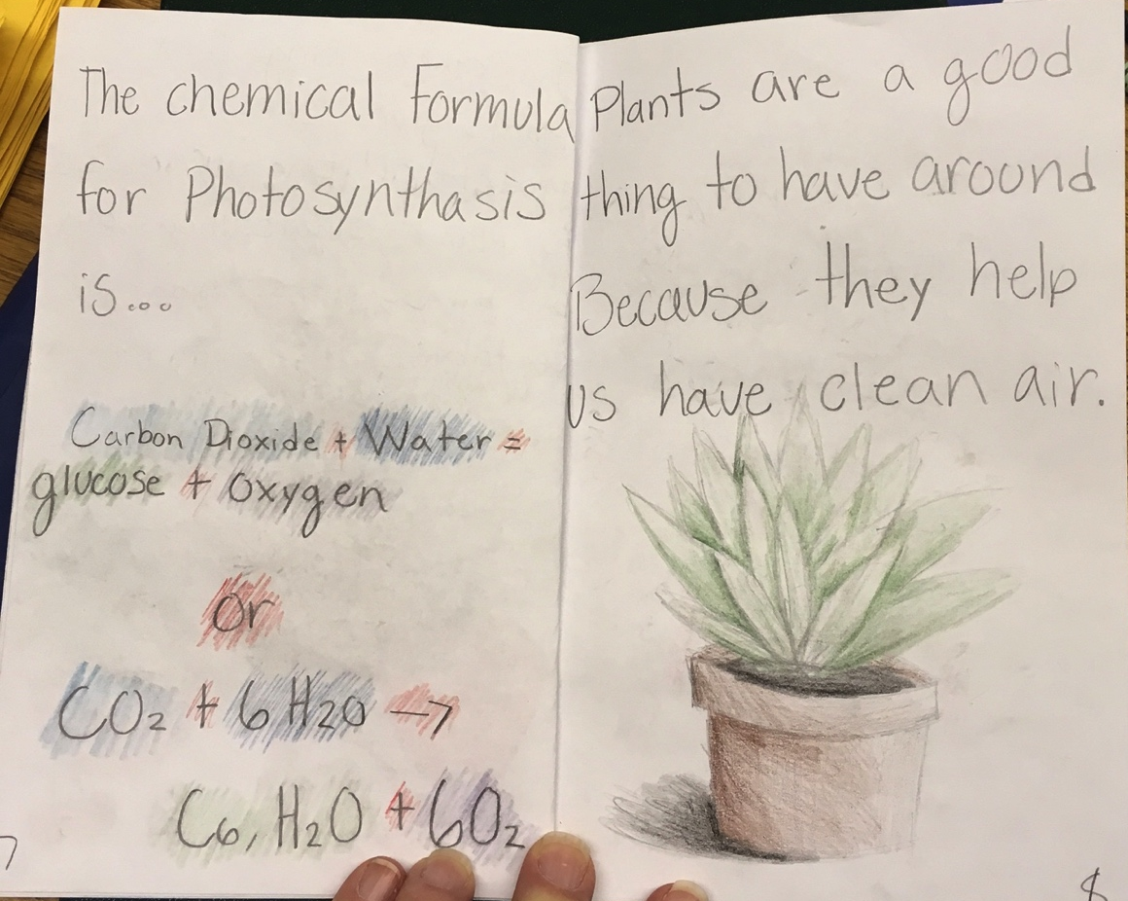
Booklet Example

Slide 11
Power Point
Create a power point presentation explaining the process of photosynthesis. Show the atoms involved as reactants and products in a balanced equation.
Discuss the importance of light energy as a part of the process.
Slides should include written information and NOT pictures.
(6 slides or more)

Slide 12
Power Point Example

Slide 13
Day 3 - Respiration
Choose ONE of these projects
Brochure
or
Poster and Explanation

Slide 14
Brochure
Create a brochure explaining how RESPIRATION in animals is a process that converts food energy into mechanical energy. Include information such as where respiration takes place and show the balanced equation for the chemical change.
Your brochure should be fully colored.
(5 sections or more)

Slide 15
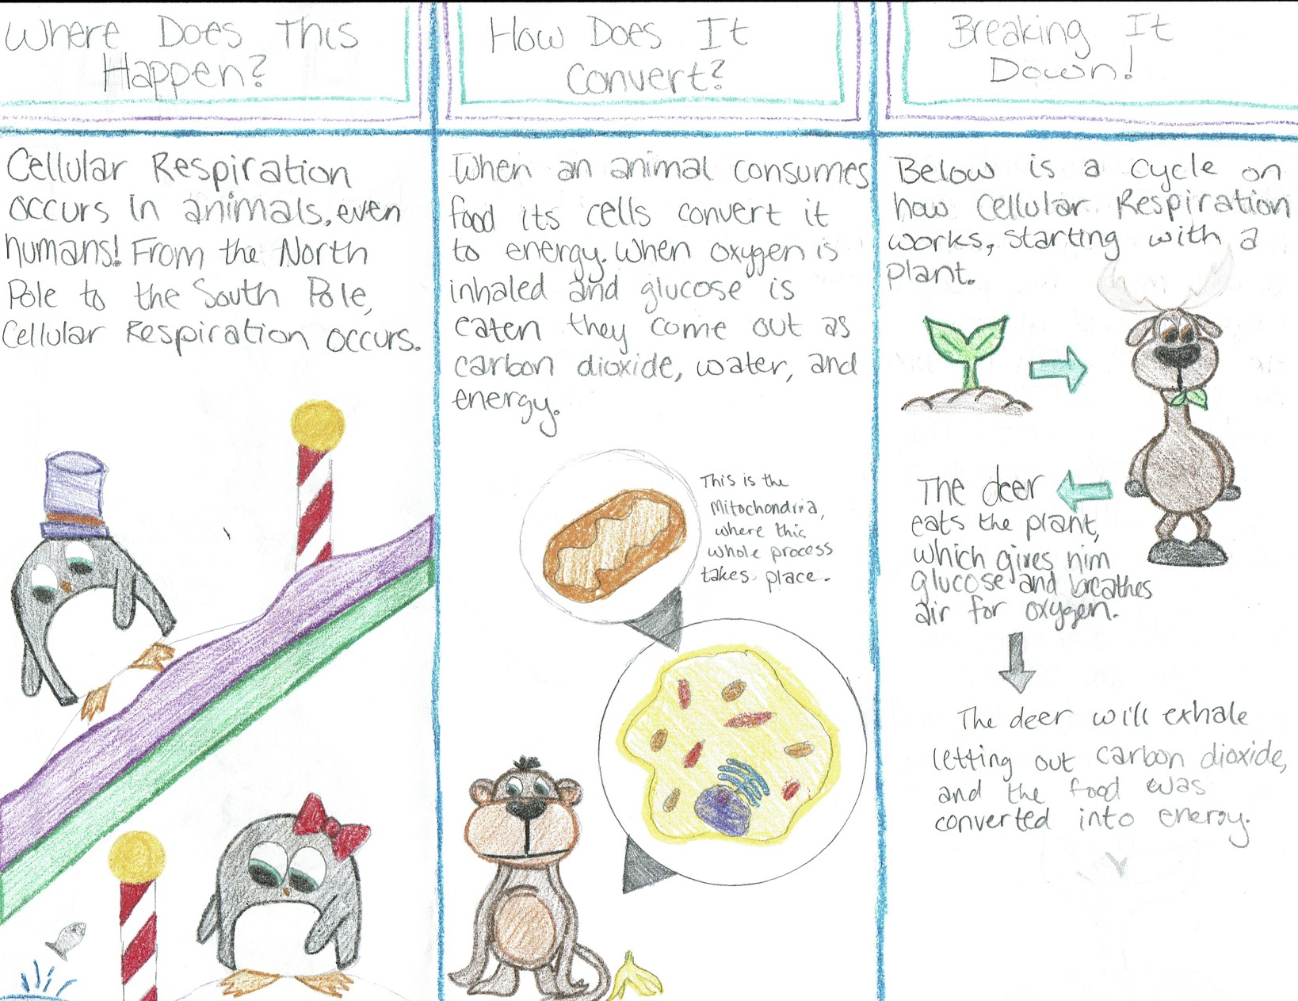
Brochure Example

Slide 16
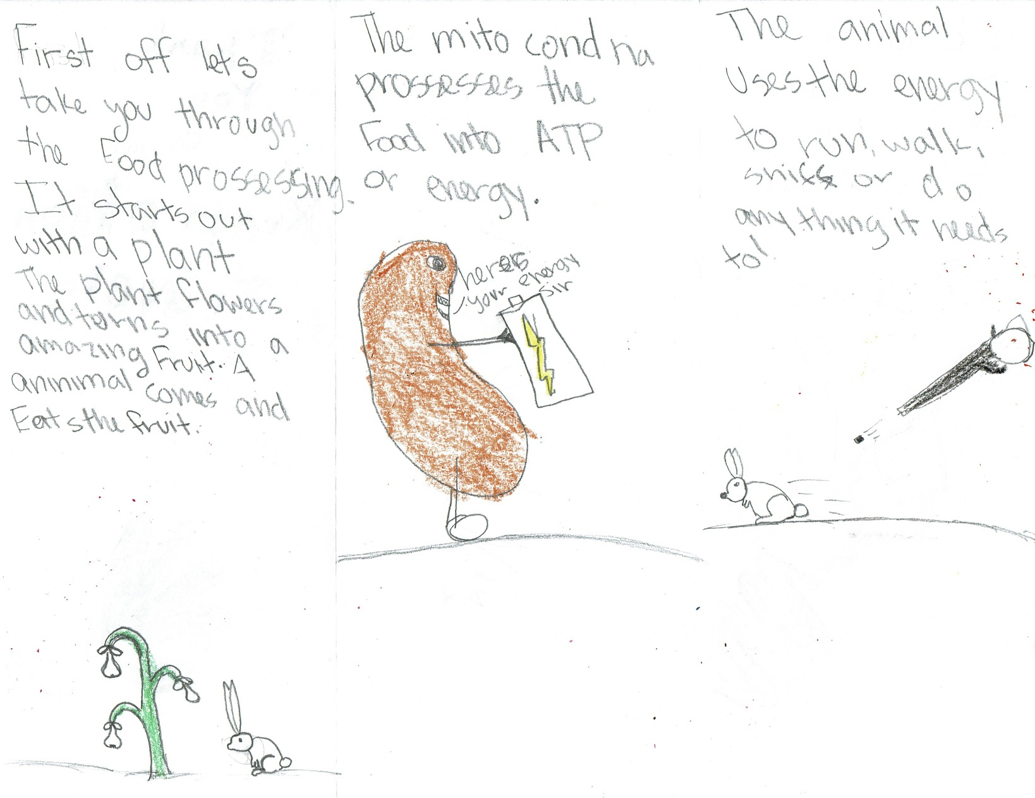
Brochure Example

Slide 17
Poster and Explanation
Differentiate between aerobic and anaerobic RESPIRATION. (Use the Blue Cells Book pages 88-90 for information.)
Design a poster with a drawing of an organism that uses each type of respiration. Write a paragraph about each organism to explain how each respires differently.
Your poster should be fully colored.
(2 paragraphs or more)

Slide 18
Poster and Explanation Example

