Slide 1
Carbon Cycle
Notes

Slide 2
Introduction Video
Carbon Cycle video on youTube

Slide 3
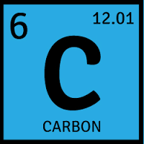
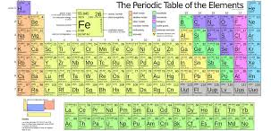
What is Carbon?

Slide 4
Carbon Cycle
Carbon is one of the elements that need to be cycled through the environment.
During the cycle, carbon moves through living (biotic) or (organic) and non-living (abiotic) or (inorganic) components.
Cycling carbon involves Biological interactions, Geological activities and Chemical reactions.

Slide 5
Why is Carbon important?
Carbon is a key element in fats, proteins, carbohydrates and nucleic acids – all items that make up living things.
For this reason, all living things on earth are called carbon based life forms.

Slide 6
Where is Carbon found?
Atmosphere (abiotic)
Oceans (abiotic)
Rocks/shells (abiotic)
Fossil fuels (abiotic)
Living things (biotic)

Slide 7
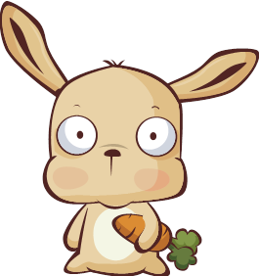
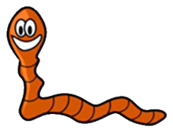
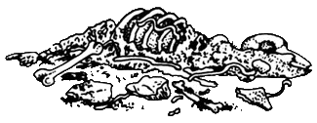
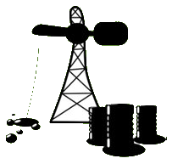
Label the components of the carbon cycle.
CARBON DIOXIDE
CO₂
PRODUCER
CONSUMER
WASTE & REMAINS
DECOMPOSER
FOSSIL FUELS

Slide 8
Carbon Storage
Long term storage
Fossil fuels
Short term storage
CO2
Tree
Rabbit
Worm
Bones

Slide 9
Label the processes of the carbon cycle.
CARBON DIOXIDE
CO₂
photosynthesis
cellular
respiration
PRODUCER
CONSUMER
assimilation
assimilation
death &
decomposition
assimilation
WASTE & REMAINS
DECOMPOSER
fossilization
combustion
FOSSIL FUELS

Slide 10
adds CO₂
removes CO₂ or keeps carbon from becoming CO₂.
CARBON DIOXIDE
CO₂
photosynthesis
cellular
respiration
PRODUCER
CONSUMER
assimilation
assimilation
death &
decomposition
assimilation
WASTE & REMAINS
DECOMPOSER
fossilization
combustion
FOSSIL FUELS

Slide 11
Video
Carbon Cycle Video

