Slide 1
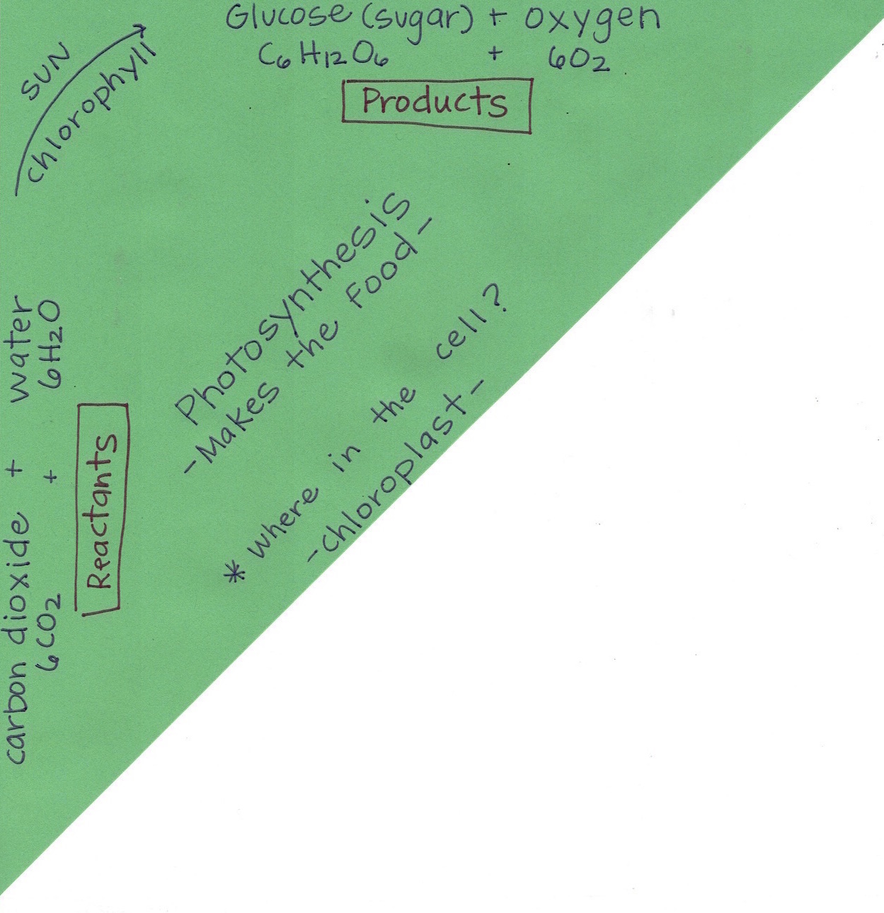
Your Photosynthesis notes SHOULD look like this…
NOW, you will complete the white portion!

Slide 2
Cellular Respiration
-Breaks the food down so it’s usable-
Cellular Respiration:
-Breaks the food down so it’s usable-
(Write the following information into the center of your triangle)

Slide 3
Where in the cell?
-Mitochondria-
Cellular Respiration:
-Breaks the food down so it’s usable-
Where in the cell?
-Mitochondria-
(Write the following information into the center of your triangle)

Slide 4
Organisms use Glucose (sugar) and 6 molecules of Oxygen… these are known as the “Reactants”
Cellular Respiration:
-Breaks the food down so it’s usable-
Where in the cell?
-Mitochondria-
Glucose (sugar) + Oxygen
C₆H₁₂O₆ 6O₂
Reactants
(Write the following information into the edge of your triangle)

Slide 5
Organisms make carbon dioxide, water and energy known as ATP.
ATP stands for Adenosine Tri-Phosphate. This gives organisms the energy to live.
Cellular Respiration:
-Breaks the food down so it’s usable-
Where in the cell?
-Mitochondria-
Glucose (sugar) + Oxygen
C₆H₁₂O₆ 6O₂
Reactants
Carbon Dioxide + Water + Energy
6CO₂ 6H₂O ATP
Products
(Write the following information into the edge of your triangle)

Slide 6
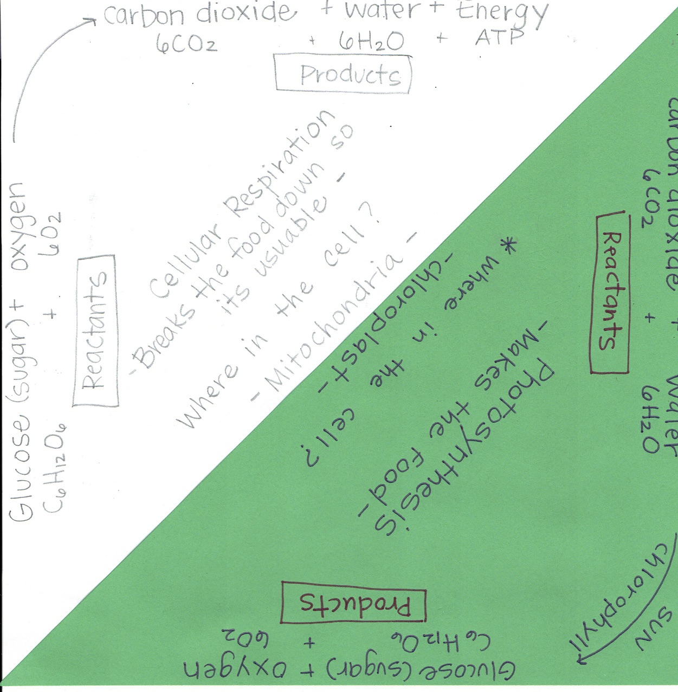
Your notes SHOULD look like this… once you are finished complete the pink assignment titled,
“Cellular Respiration”

