Slide 1
Potential and Kinetic Energy
(Make a foldable set of notes)

Slide 2
What is Energy?
Energy = The ability to do work

Slide 3
What is Work?
An object has to supply a force for another object to be displaced to be considered work.

Slide 4
Potential Energy
Stored energy that COULD do work.

Slide 5
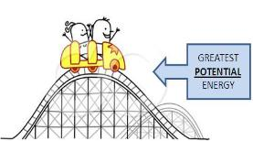
Potential

Slide 6
Kinetic Energy
Energy that DOES work.

Slide 7
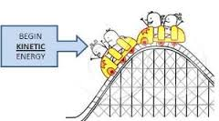
Kinetic

Slide 8
Types of Potential Energy
Chemical = Energy that will be released during a chemical reaction
Eating food
Batteries in your phone
Gasoline in a car

Slide 9
Types of Potential Energy
Gravitational= Energy because of its position
Sled at the top of a snowy hill
Roller coaster at the top of a hill
Apple hanging on a tree

Slide 10
Type of Kinetic Energy
Mechanical = Energy of motion
Rock rolling down a hill
Coaster running down the track
Apple falling from a tree

Slide 11
Types of Kinetic Energy
Sound = movement of energy through waves
Vibrations

Slide 12
Types of Kinetic Energy
Heat = Movement of energy through particles
Temperature

Slide 13
Lets Review!
Roller Coaster Animation

Slide 14
Lets Practice!

Slide 15
Kinetic or Potential?

Slide 16
Kinetic or Potential?

Slide 17
Kinetic or Potential?

Slide 18
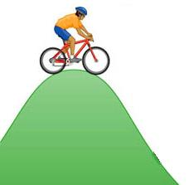
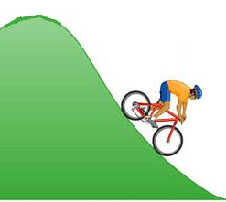
Kinetic or Potential?

Slide 19
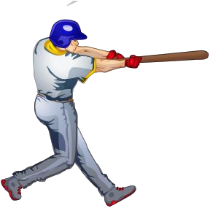
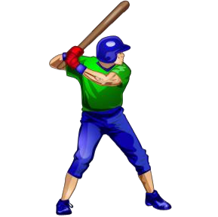
Kinetic or Potential?

Slide 20
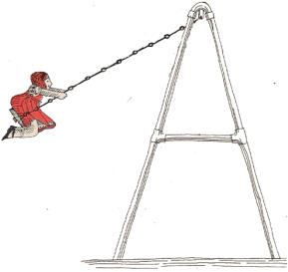
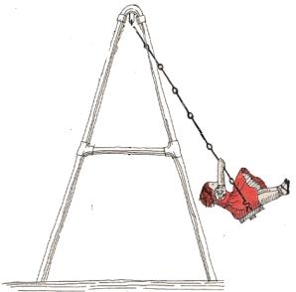
Kinetic or Potential?

Slide 21
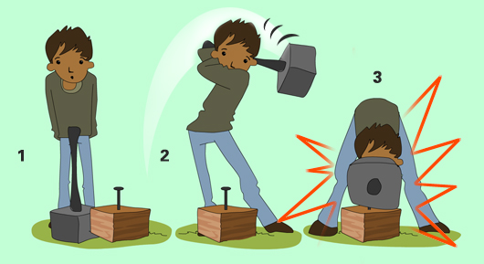
Describe the energy in this picture
The iron hammer on its own has no kinetic energy, but it has some potential energy because of its weight. To drive a nail into the piece of wood (which is work), he has to lift the iron hammer up, which increases its potential energy because if its high position. He then has to force it to move at great speed downwards (now has kinetic energy) to hit the nail.

