Slide 1
Mystery Boxes
Finding Evidence and Making Inferences

Slide 2
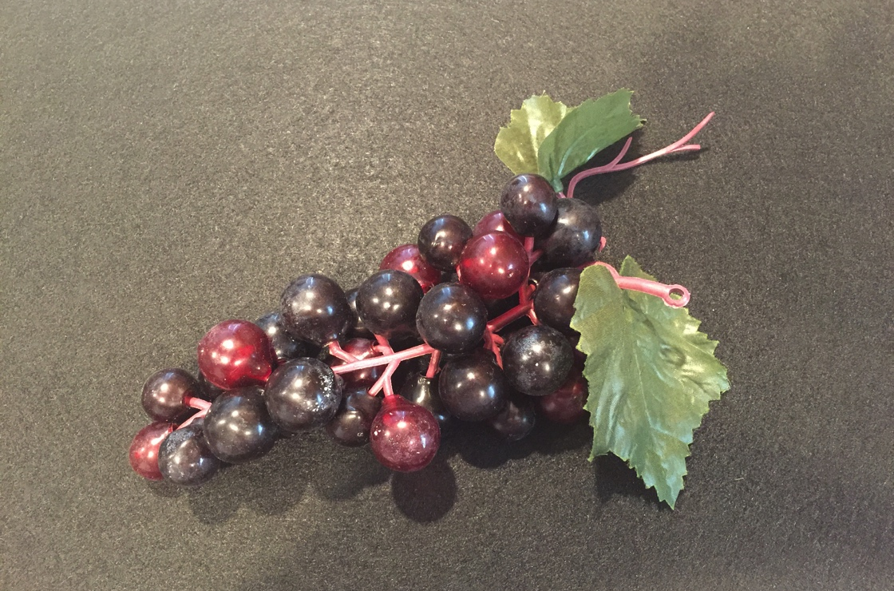
Box #1
Plastic Grapes

Slide 3
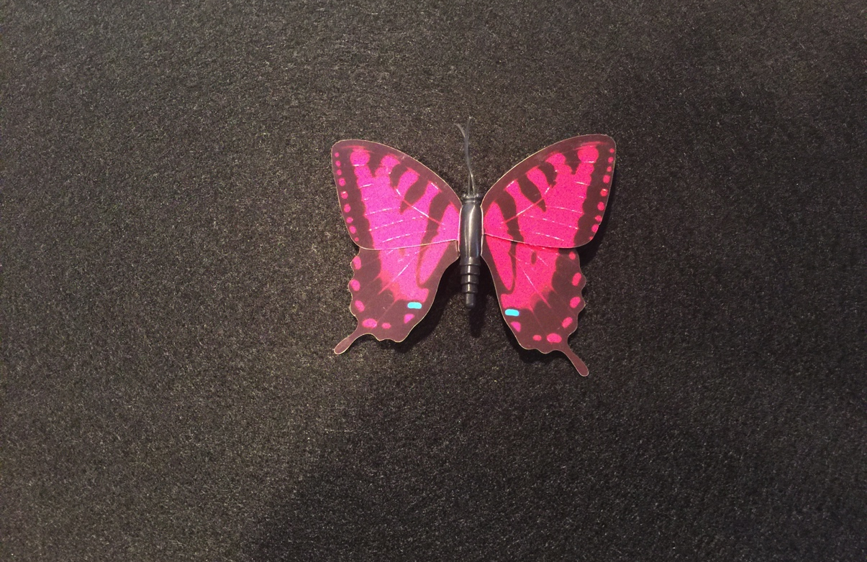
Box #2
Plastic Butterfly

Slide 4
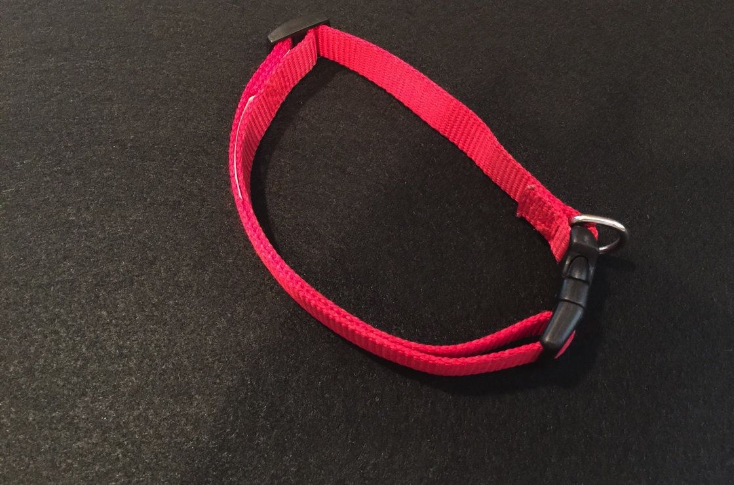
Box #3
Red Dog Collar

Slide 5
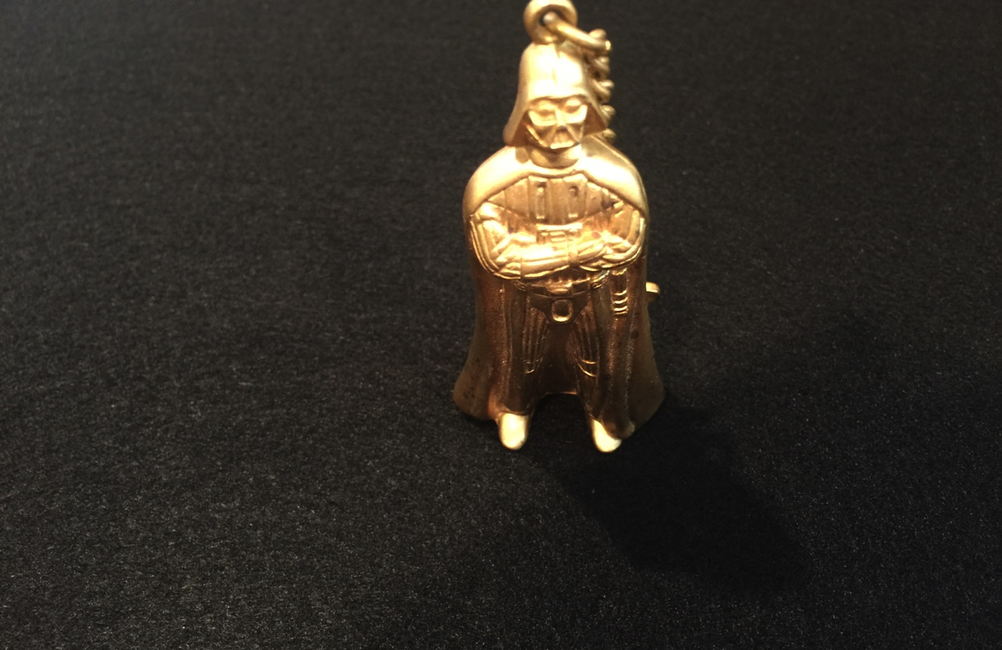
Box #4
Gold Star Wars Key Chain: Darth Vader

Slide 6
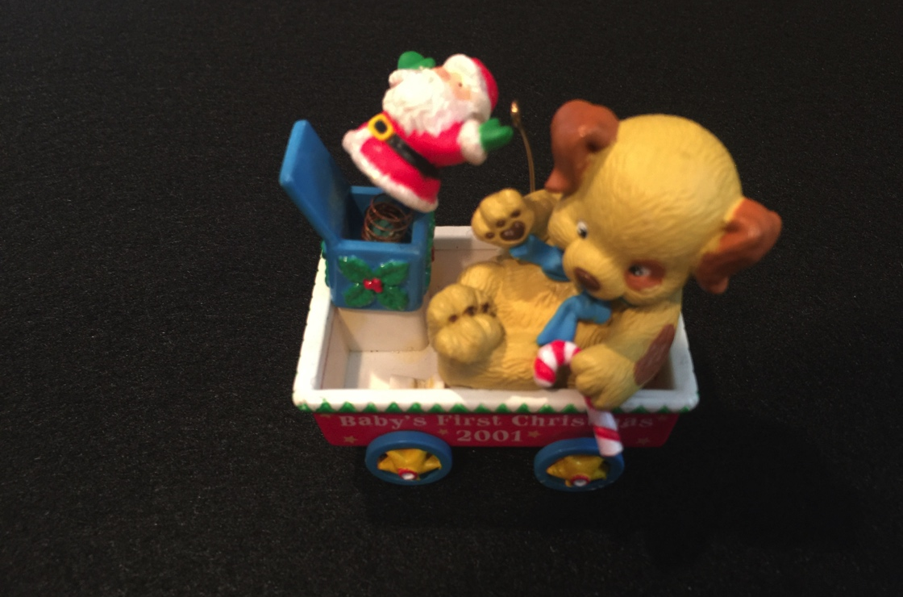
Box #5
Christmas Ornament

Slide 7
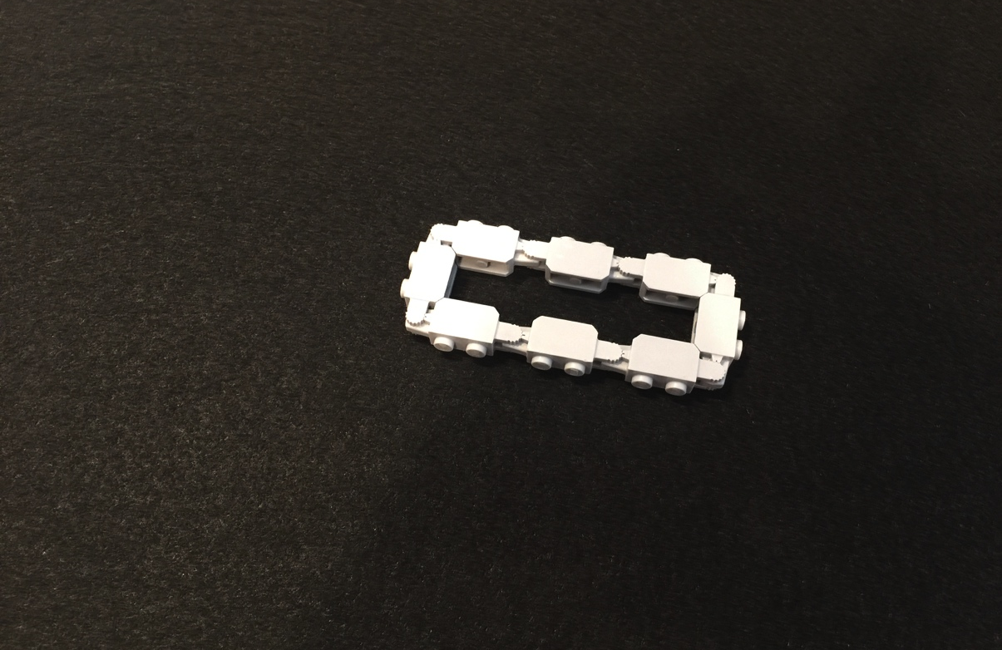
Box #6
Lego Chain

Slide 8
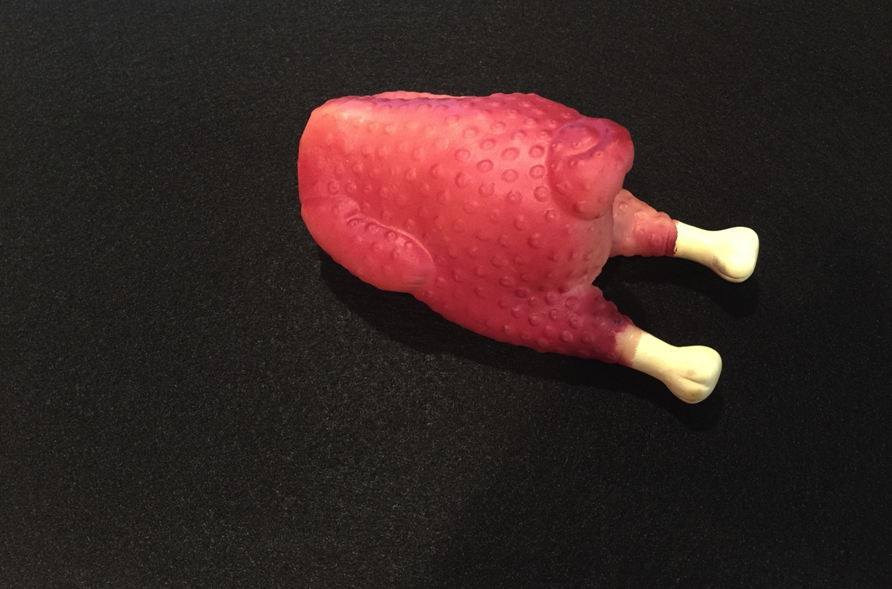
Box #7
Plastic Dog Toy: Chicken

Slide 9
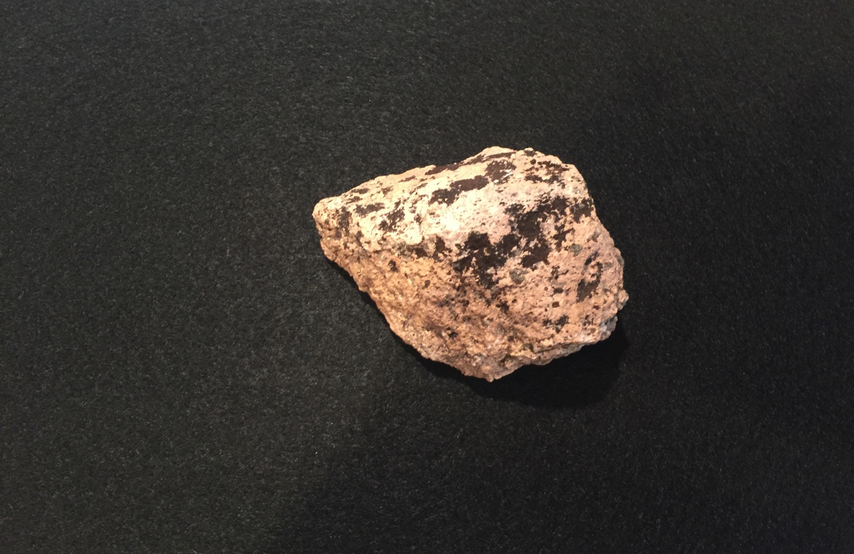
Box #8
Rock

