Slide 1
Physical and Chemical Properties Notes
8th Grade Science

Slide 2
All substances have properties that we can use to identify them.

Slide 3
How do we identify a person? By their face, their voice, height, finger prints, DNA etc..
The more of these properties that we can identify, the better we know the person.

Slide 4
In a similar way matter has properties or qualities or traits belonging to an object. The more of these properties that we can identify, the better we know the substance.

Slide 5
There are two types of properties: chemical and physical.

Slide 6
Chemical Properties
Definition: Properties that DO change the chemical nature of matter.

Slide 7
Flammability
Does it burn?

Slide 8
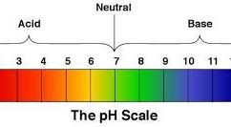
pH
How acidic is it?

Slide 9
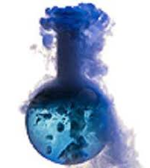
Reactivity
Does it react with air , oxygen or water?

Slide 10
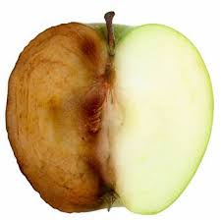
Decay
Will it break down over time?

Slide 11
Rusting

Slide 12
Physical Properties
Definition: Properties that DO NOT change the chemical nature of matter.

Slide 13
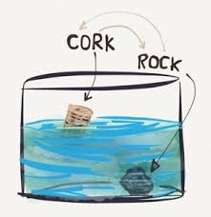
Density

Slide 14
Color

Slide 15
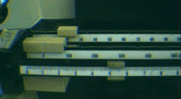
Mass

Slide 16
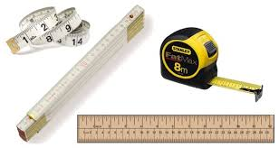
Length

Slide 17
State of Matter

Slide 18
Shininess

Slide 19
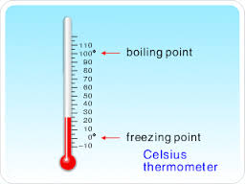
Boiling, Freezing, Melting Points

Slide 20
Viscosity

Slide 21
And so on……

