Slide 1
Synthetic Materials
8th Grade Science

Slide 2
NATURAL RESOURCES
Natural resources are things, materials, substances and components found in the natural environment.
Natural resources exist “naturally” in the world. They are not the result of human manipulation or creation.
What is a natural resource?
Natural Resources

Slide 3
NATURAL RESOURCES PICTURE

Slide 4
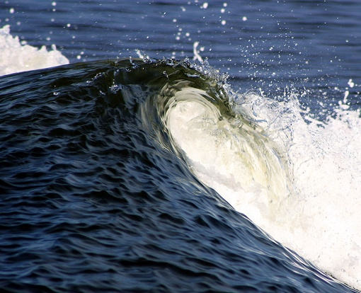
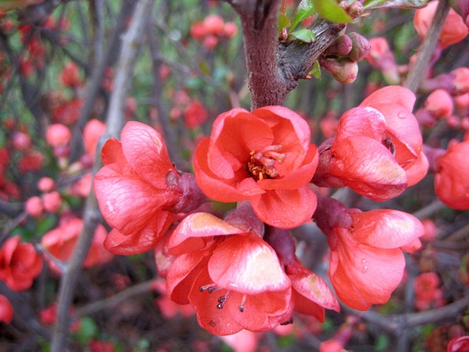
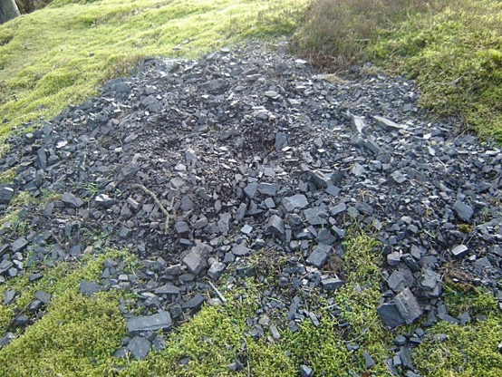
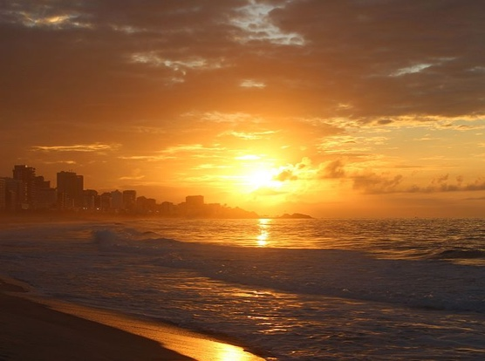
NATURAL RESOURCES
Natural resources can be living or non-living.
Plants, animals, rocks and minerals are natural resources
The sun, fossil fuels, soil, water and wind are natural resources as well
Natural Resources

Slide 5
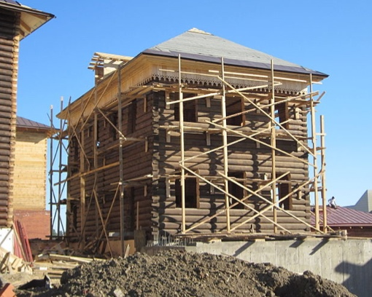
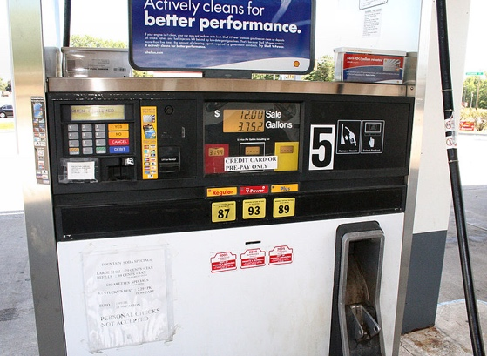
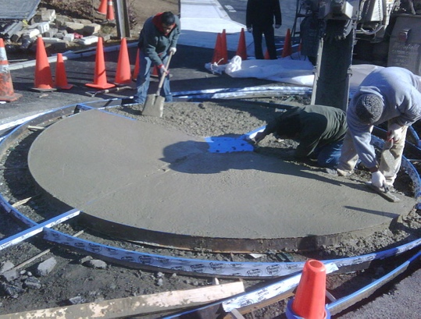
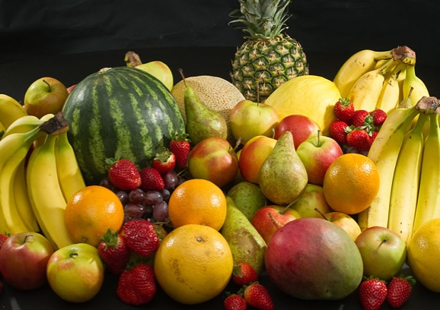
NATURAL RESOURCES
We use natural resources for many things:
We use energy from natural resources for transportation, to generate electricity and to manufacture products.
We use natural resources for food. These resources – specifically plants and animals - provide energy that “fuels” our bodies.
We use natural resources to construct houses, buildings and roads.
Natural Resources

Slide 6
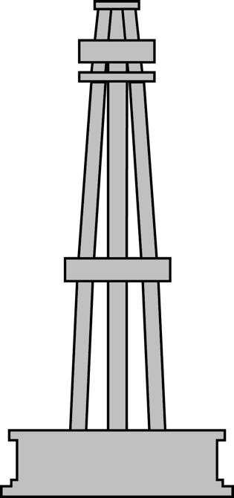
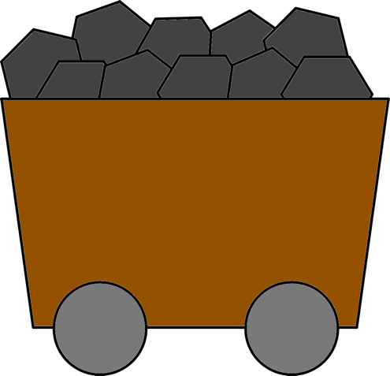
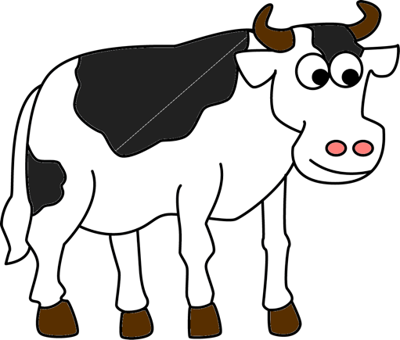
NATURAL RESOURCES
There are two kinds of natural resources:
Renewable resources
Nonrenewable resources
Natural Resources

Slide 7
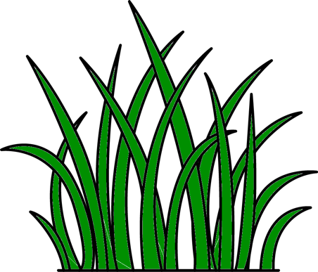
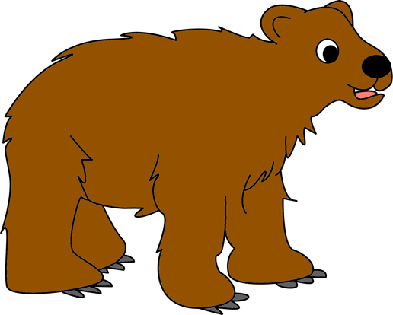
RENEWABLE RESOURCES
Renewable resources can regenerate if they are living or replenished by biochemical cycles if they are non-living.
Water, sunlight, plants, animals and wind are renewable resources.
Natural Resources

Slide 8
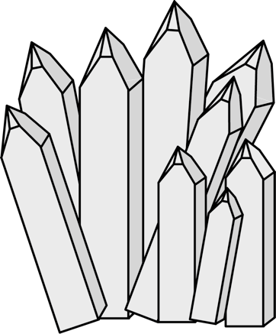
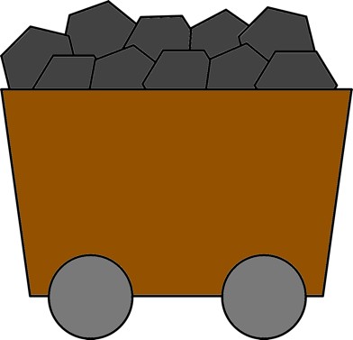
NONRENEWABLE RESOURCES
Nonrenewable resources CANNOT be regenerated or replenished by natural processes.
There is a finite amount of nonrenewable resources - once used up, they are forever gone.
Fossil fuels (coal, oil and natural gas), minerals and metals are nonrenewable resources.
Natural Resources

Slide 9
NONRENEWABLE RESOURCES
Renewable resources can become nonrenewable resources if they are used up faster than they can be replenished.
If the resource no longer exists, there is nothing to regenerate or be replenished.
Example: If we cut down trees faster than we grow them, trees can become a nonrenewable resource because there are no trees to regenerate.
Natural Resources

Slide 10
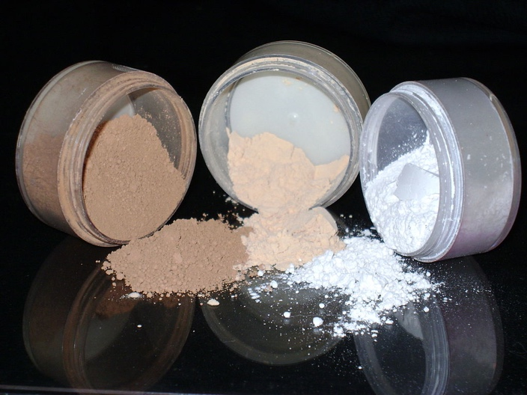
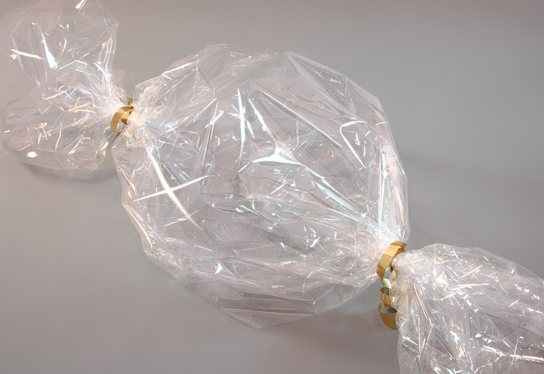
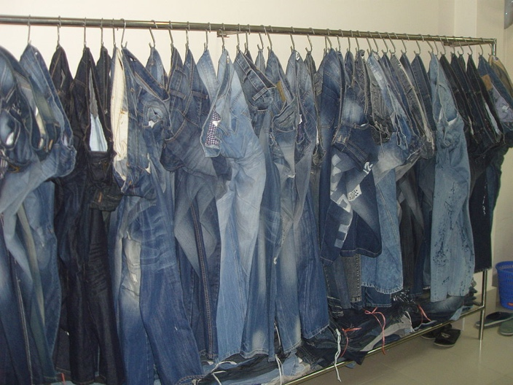
SYNTHETIC PRODUCTS
Human use natural resources to make synthetic products.
Synthetic products are man-made materials and substances.
Synthetic products are artificial - they do NOT exist naturally in the environment.
Natural Resources

Slide 11
SYNTHETIC MATERIALS PICTURE

Slide 12
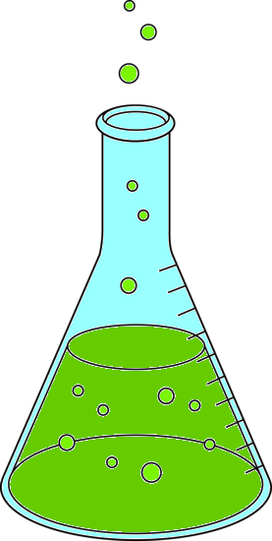
SYNTHETIC PRODUCTS
A synthetic product is made through chemical reactions.
Natural resources are chemically changed or modified during chemical reactions to make synthetic products.
Humans can chemically change or modify all kinds of natural resources to make synthetic products.
We can make synthetic products from plants and animals as well as from metals, minerals and other natural resources found within Earth.
Natural Resources

Slide 13
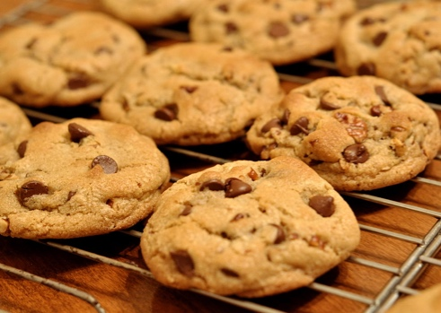
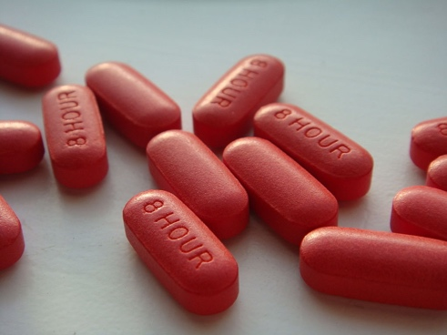
PLANT-BASED PRODUCTS
Plant-based products are synthetic products made from plants.
Plants can be used to make food. Wheat, corn and sugar cane are plants. We use parts of these plants as ingredients to make food such as bread, chips and cookies.
Plants can be used to make medicine. Many medicines that treat pain, acne and infectious diseases are made from plant parts and plant oil.
Plants can be used to make clothes. For example, we use fibers from cotton to make cotton fabric.
Plants can be used to make lotions and cosmetics.
Natural Resources

Slide 14
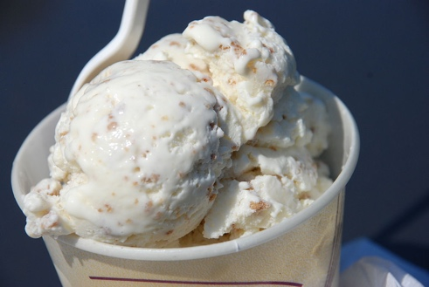
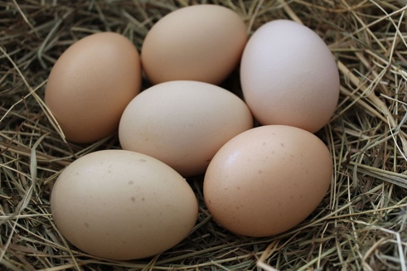
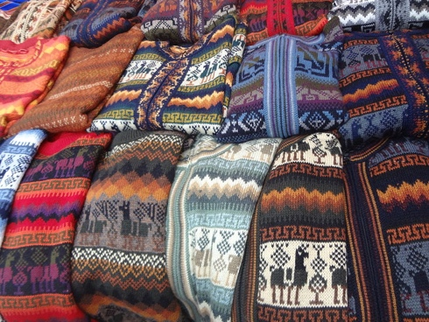
ANIMAL-BASED PRODUCTS
Animal-based products are synthetic products made from animals.
Animals can be used to make clothing. We use fibers from animals, such as wool from sheep and cashmere from goats to make sweaters, coats and other items.
Animals can be used to make food. We use eggs from chickens and milk from cows as ingredients to make all sorts of food items.
Gelatin in a natural substance obtained from animals. Gelatin is used as a gelling agent in foods such ice cream and marshmallows. It can be used to make the shell of medical capsule in order to make swallowing pills easier.
Natural Resources

Slide 15
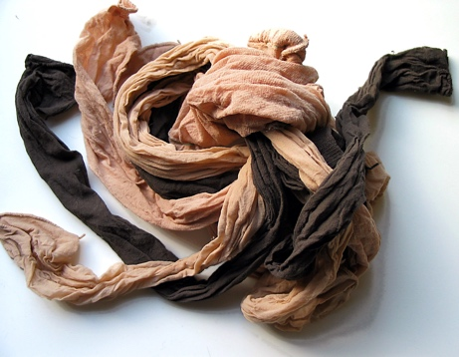
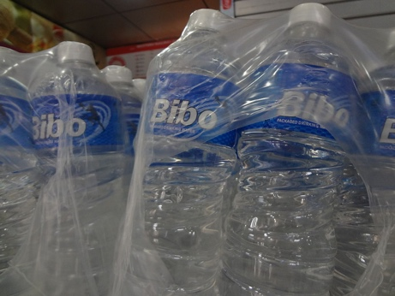
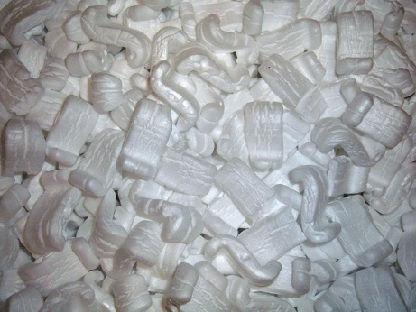
PETROLEUM-BASED PRODUCTS
Petroleum-based products are synthetic products made from petroleum or crude oil.
Crude oil (simply called oil) is a fossil fuel. We use crude oil as a major source of energy. It is refined to make gasoline.
We use crude oil to make many other synthetic products as well.
Crude oil is used to make different kinds of plastics, including PVC, vinyl and styrofoam.
Crude oil is used to make nylon and polyester, which are often used in clothing.
Crude oil is used to make lubricants, waxes and tar.
Natural Resources

