Slide 1
Types of energy

Slide 2
mechanical
Transfer of energy through motion
*windmills
*roller coasters

Slide 3
mechanical

Slide 4
Kinetic/potential
Kinetic = energy that does work
*wind
*running water
Potential = stored energy that could do work
*gasoline
*sled at the top of a hill

Slide 5
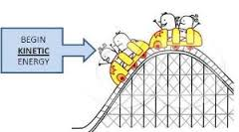
Kinetic potential

Slide 6
nuclear
Energy that is released from a nuclear reaction
*atom splitting
*radioactive decay

Slide 7
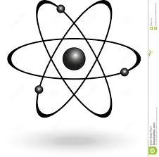
nuclear

Slide 8
electrical
Energy found in a current of electrons
*lamp
*lightening

Slide 9
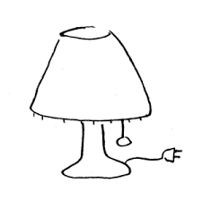
electrical

Slide 10
Heat/thermal
Transfer of energy through particles, measured by temperature
*fire
*steam

Slide 11
Heat/thermal

Slide 12
chemical
Stored energy in any type of fuel source
*gasoline
*food
*batteries

Slide 13
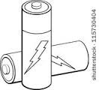
chemical

Slide 14
light
Energy from the sun or any luminous object
*sun
*x-rays

Slide 15
light

Slide 16
sound
Transfer of energy through vibrations
*guitar playing
*thunder
*radio

Slide 17
sound

