Slide 1
Waves Notes
8th Grade Science: Physics

Slide 2
Format of our notes…
Outside Cover of the notes

Slide 3
Resting point
Resting Point
The resting point is the point on the waves where it would come to a “REST”…
Short Terms…
The FLAT LINE!

Slide 4
Waves notes
Amplitude

Slide 5
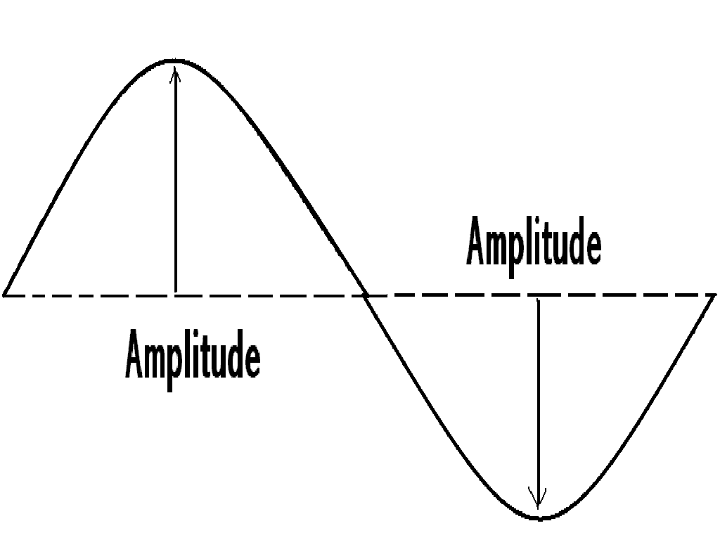
Amplitude
The maximum height of a wave measured from its
resting point.

Slide 6
Waves notes
Crest

Slide 7
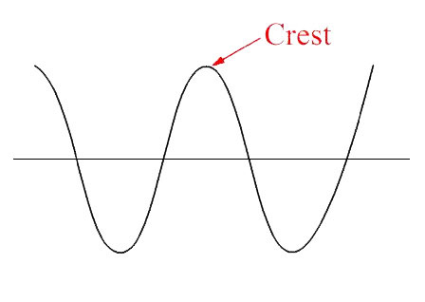
Crest
The point on a wave with maximum value or the highest point.

Slide 8
Waves notes
Trough

Slide 9
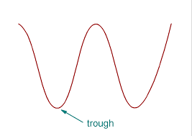
Trough
The point on a wave with the minimum value or lowest point.

Slide 10
Waves notes
Wavelength

Slide 11
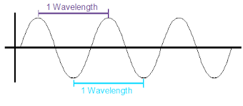
wavelength
The distance between corresponding points of two consecutive waves.
Ex. Crest to Crest
OR
Trough to Trough

Slide 12
Waves notes
Frequency

Slide 13
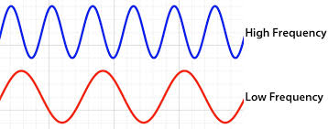
frequency
The number of waves that pass a certain point in a given amount of time.

Slide 14
Waves notes
Medium

Slide 15
Medium
The substance through which waves can travel.
Solid
Liquid
Gas

Slide 16
Waves notes
Transverse Waves

Slide 17
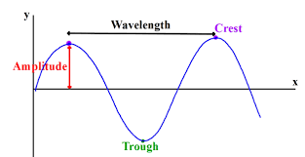
Transverse Waves
Wave type in which particles of the medium move up and down at right angles to the direction of the wave motion.

Slide 18
Waves notes
Longitudinal Waves

Slide 19
Longitudinal Waves
Compression:
Particles close together.
Rarefaction:
Particles far apart.
Wave type in which particles of the medium move back and forth in the direction of the wave motion.

